Slide 1
Naïve Bayes
Text mining and language understanding
Dr. K. V Dakshinamurthy
President, INSOFE

Slide 2
TF, IDF computation

Slide 3
Document Collection Representation
A collection of n documents can be represented in the vector space model by a term-document matrix.
An entry in the matrix corresponds to the “weight” of a term in the document; zero means the term has no significance in the document or it simply doesn’t exist in the document.
T₁ T₂ …. T_{t}
D₁ w₁₁ w₂₁ … w_{t1}
D₂ w₁₂ w₂₂ … w_{t2}
: : : :
: : : :
D_{n} w_{1n} w_{2n} … w_{tn}

Slide 4
Term Weights: Term Frequency (TF)
More frequent terms in a document are more important, i.e. more indicative of the topic.
f_{ij} = frequency of term i in document j
May want to normalize term frequency (tf) across the entire corpus:
tf_{ij} = f_{ij} / max{f_{ij}}

Slide 5
Term Weights: Inverse Document Frequency (IDF)
Terms that appear in many different documents are less indicative of overall topic.
df _{i} = document frequency of term i
= number of documents containing term i
idf_{i} = inverse document frequency of term i,
= log₂ (N/ df _{i})
(N: total number of documents)
An indication of a term’s discrimination power. Log used to dampen the effect relative to tf.

Slide 6
TF-IDF Weighting
A typical weighting is tf-idf weighting:
w_{ij} = tf_{ij} idf_{i} = tf_{ij} log₂ (N/ df_{i})
A term occurring frequently in the document but rarely in the rest of the collection is given high weight.
Experimentally, tf-idf has been found to work well. It was also theoretically proved to work well (Papineni, NAACL 2001)

Slide 7
Computing TF-IDF: An Example
Given a document containing terms with given frequencies:
A(3), B(2), C(1)
Assume collection contains 10,000 documents and
document frequencies of these terms are:
A(50), B(1300), C(250)
Then:
A: tf = 3/3; idf = log(10000/50) = 5.3; tf-idf = 5.3
B: tf = 2/3; idf = log(10000/1300) = 2.0; tf-idf = 1.3
C: tf = 1/3; idf = log(10000/250) = 3.7; tf-idf = 1.2

Slide 8
NB practical aspects

Slide 9
Unigram and higher-order models
Sec.13.2.1
P ( )
Unigram Language Models
Bigram (generally, n-gram) Language Models
Other Language Models
Grammar-based models (PCFGs), etc.
= P ( )
P ( | )
P ( | )
P ( | )
P ( ) P ( ) P ( ) P ( )
P ( ) P ( | ) P ( | ) P ( | )

Slide 10
Naive Bayes via a class conditional language model
Sec.13.2
C
w₁
w₂
w₃
w₄
w₅
w₆
Effectively, the probability of each class is done as a class-specific unigram language model

Slide 11
Naïve Bayes classifier: words and topics
A set of labeled documents is given:
{C_{d},w_{d}: d=1,…,D}
Note: classes are mutually exclusive
. . .
c₁=8
c₁=2
c_{d}=D
. . .
Pet
Dog
Milk
Cat
Eat
Food
Dry
Milk
Bread

Slide 12
Using Naive Bayes Classifiers to Classify Text: Basic method
Attributes are text positions, values are words.
Still too many possibilities
Assume that classification is independent of the positions of the words
Use same parameters for each position
Bag of words model

Slide 13
Estimating probabilities
When Nc is small, however, such approach provides poor estimation. To avoid this difficulty, we can adopt the m-estimate of probability
where P is the prior estimate of the probability we wish to estimate, m is a constant called the equivalent sample size.
A typical method for choosing P in the absence of other information is to assume uniform priors: If an attribute has k possible values we set P=1/K.
For example, P( wind =strong | play tennis=no), we note wind has two possible values, so uniform priors means P = ½

Slide 14
Estimating probabilities
From training corpus, extract Vocabulary
Calculate required P(c_{j}) and P(x_{k} | c_{j}) terms
For each c_{j} in C do
docs_{j} ← subset of documents for which the target class is c_{j}
Text_{j} ← single document containing all docs_{j}
for each word x_{k} in Vocabulary
n_{k} ← number of occurrences of x_{k} in Text_{j}

Slide 15
NB: Classifying
Return c_{NB}, where

Slide 16
The Problem of Underflow
Sec.13.2
Multiplying lots of probabilities, which are between 0 and 1 by definition, can result in floating-point underflow.
Since log(xy) = log(x) + log(y), it is better to perform all computations by summing logs of probabilities rather than multiplying probabilities.
Class with highest final un-normalized log probability score is still the most probable.
Note that model is now just max of sum of weights…

Slide 17
Feature Selection
Sec.13.5
Text collections have a large number of features
10,000 – 1,000,000 unique words … and more
May make using a particular classifier infeasible
Some classifiers can’t deal with 100,000 of features
Feature selection reduces training time
Training time for some methods is quadratic or worse in the number of features
Can improve generalization (performance)
Eliminates noise features
Avoids overfitting

Slide 18
Feature selection
Sec.13.5.1
Using any method, for each category we build a list of k most discriminating terms.
For example (on 20 Newsgroups):
sci.electronics: circuit, voltage, amp, ground, copy, battery, electronics, cooling, …
rec.autos: car, cars, engine, ford, dealer, mustang, oil, collision, autos, tires, toyota, …
Greedy: does not account for correlations between terms

Slide 19

Feature Selection: Summary
Sec.13.5
Mutual Information
Clear information-theoretic interpretation
May select very slightly informative frequent terms that are not very useful for classification

Slide 20
Feature selection
Chi-square
Statistical foundation
May select rare uninformative terms
Just use the most common terms?
No particular foundation
In practice, this is often 90% as good

Slide 21
Summary: A Practical NB Classifier
Simple interpretation: Each conditional parameter log P(x_{i}|c_{j}) is a weight that indicates how good an indicator x_{i} is for c_{j}.
The prior log P(c_{j}) is a weight that indicates the relative frequency of c_{j}.
The sum is then a measure of how much evidence there is for the document being in the class.
We select the class with the most evidence for it

Slide 22
Example 1
Training set | docID |  | c = China?
 | 1 | Chinese Beijing Chinese | Yes
 | 2 | Chinese Chinese Shangai | Yes
 | 3 | Chinese Macao | Yes
 | 4 | Tokyo Japan Chinese | No
Test set | 5 | Chinese Chinese Chinese Tokyo Japan | ?
Two classes: “China”, “not China”
V = {Beijing, Chinese, Japan, Macao, Tokyo}
N = 4

Slide 23
Example 1 (contd.)
Training set | docID |  | c = China?
 | 1 | Chinese Beijing Chinese | Yes
 | 2 | Chinese Chinese Shangai | Yes
 | 3 | Chinese Macao | Yes
 | 4 | Tokyo Japan Chinese | No
Test set | 5 | Chinese Chinese Chinese Tokyo Japan | ?
Estimation
Classification

Slide 24
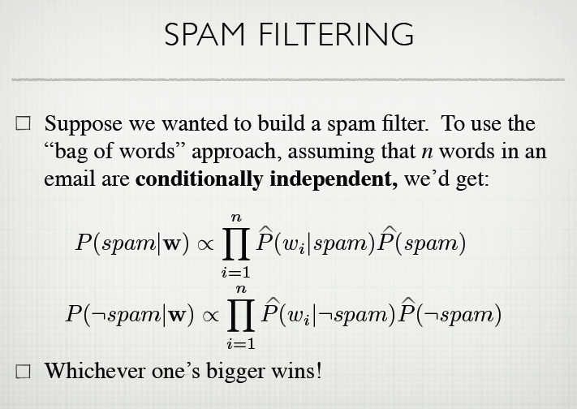
Example 2Email Spam filtering

Slide 25

Training data: a corpus of email messages, each message annotated as spam or no spam.
Task: classify new email messages as spam/no spam.

Slide 26
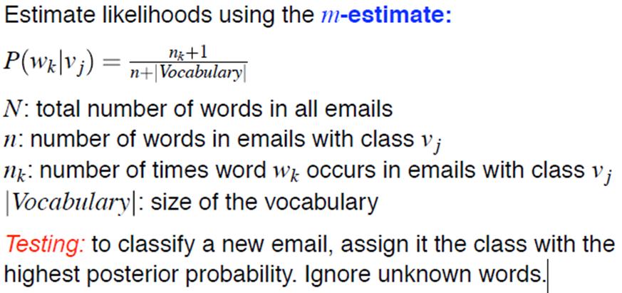

Slide 27
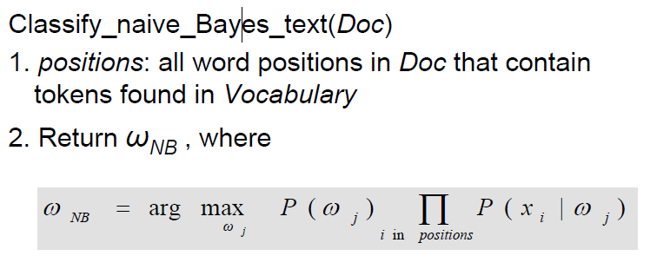
Example 2

Slide 28
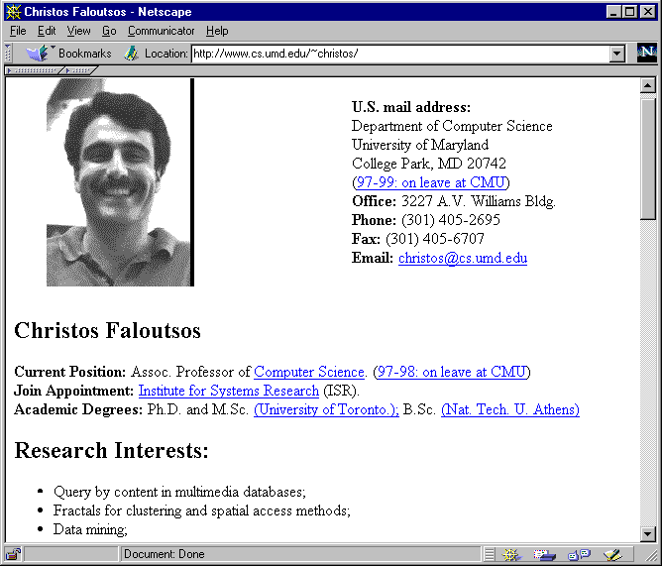
WebKB Experiment
Sec.13.6
Classify webpages from CS departments into:
student, faculty, course,project
Train on ~5,000 hand-labeled web pages
Cornell, Washington, U.Texas, Wisconsin
Crawl and classify a new site (CMU)
Results:

Slide 29
